Slide 1
Background
Problem Statement
The current regulatory reporting estate is highly fragmented.
Each report operates with its own logic, data model, extraction process, and transformation approach, resulting in
minimal re‑use,
duplicated effort,
and inconsistent outcomes.
There is a need to assess regulatory reporting holistically and define a modernised end‑state architecture that promotes:
Standardised and re‑usable data models
AI‑enabled automation and acceleration across requirements, design, testing, and documentation
Demonstrable delivery accelerators that reduce cost and cycle time
Proven techniques and tooling grounded in practical experience
The objective is to move from today’s siloed reporting environment to a unified, efficient, AI‑ready regulatory reporting ecosystem with consistent processes, shared components, and scalable foundations.

Slide 2
High Level RRaaS Scope
Regulatory Authorities
Financial Institution
FCA
Regulatory definitions and interpretations
Scope
Frequency
Data field definitions
Validation rules
Report compilation and transmission
Reconciliations
Impact Analysis
Agent
Requirement Agent
PRA
BOE
Knowledge Base
Etc….
Regulatory Status
Policies
Processes
Data Architecture
Service Definitions
Evolving o/s standards
Application Architecture
Report History
COREP
FINREP
Regulatory Reporting Platform(s)
Pillar 2
Etc….
Reporting Recipient(s)

Slide 3
Reg Reporting Architecture Demo Overview
Axet Gaia – Single Pain of Glass
Context & Interface
Governance
Productivity Workflow Layer
Kano– Knowledge Management
Automated SDLC
Regulatory Reporting Engine
Requirements
Designs, test cases
Compliance & Impact Analysis
Report Generation
Validation & Controls
Repository
Kano– Knowledge Graph
Transformation Mapping
Multi-Modal Ingestion
Exate – Data
Classification
Taxonomy
Lineage
Hadoop – Big Data
Reporting Regulations
Data Analytics
Data mining
PRA/FCA data handling
GDPR constraints on customer attributes appearing in reports
Cross‑jurisdiction residency controls (e.g., EU, UK, US)

Slide 4
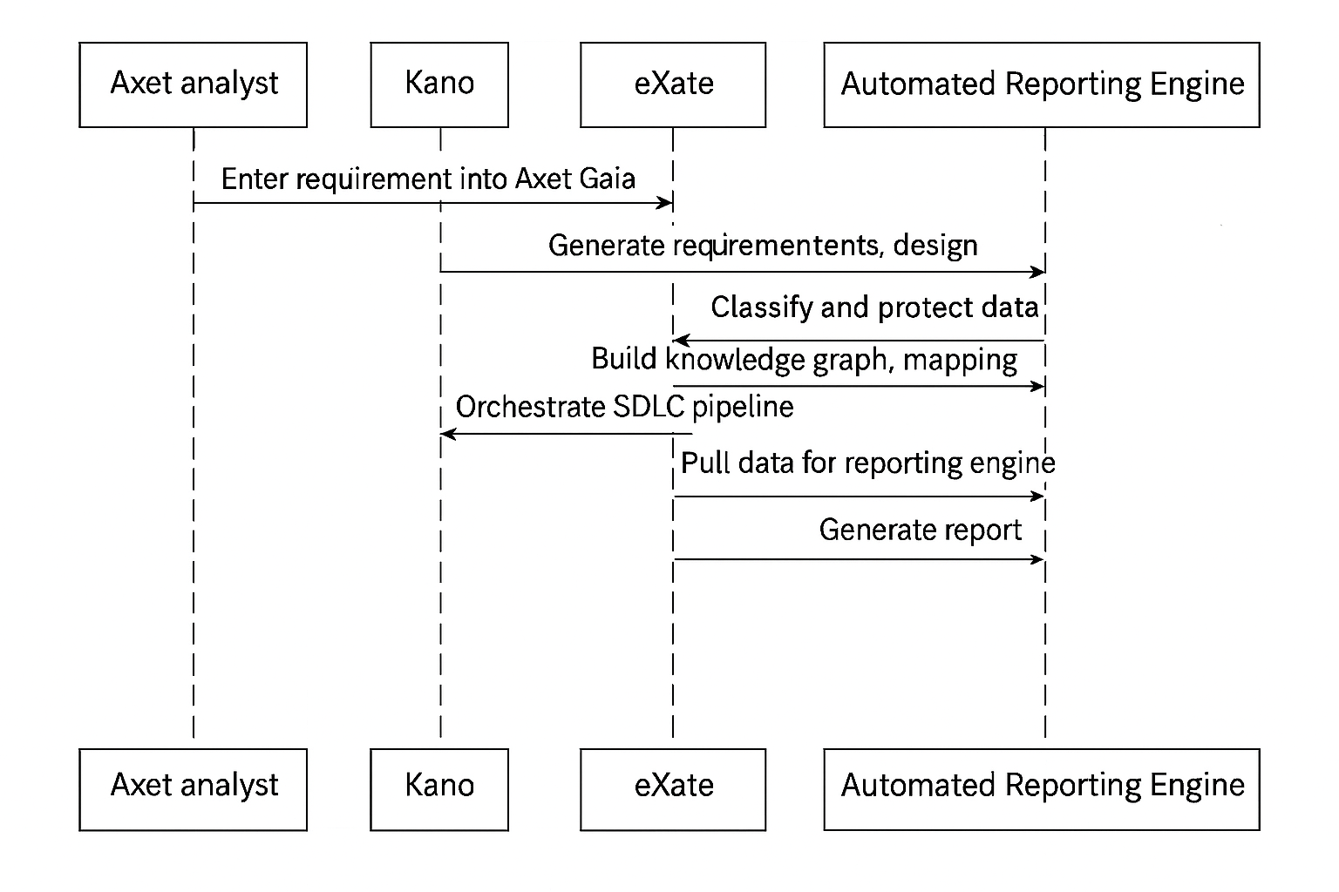
Reg Reporting Sample Flow
SME enters PRA change request into Axet Gaia.
Gaia interprets rules and sends structured requirement to Kano.
Kano generates requirements, design, ontology updates, and tests.
Data sources identified in Hadoop.eXate classifies data, enforces masking and residency controls.
Kano builds mappings and tests via the knowledge graph.
Axet orchestrates SDLC gates (policy check → tests → promotion).
Reporting Engine produces validated COREP C.07 output.
Gaia produces the full audit‑ready explanation pack.
Report delivered to PRA with full traceability.

